Slide 1

Visual C sharp® How to Program
Sixth Edition
Chapter 10
Classes and Objects: A Deeper Look
Slides in this presentation contain hyperlinks. JAWS users should be able to get a list of links by using INSERT+F7
Copyright © 2017 Pearson Education, Inc. All Rights Reserved
Notes:
If this PowerPoint presentation contains mathematical equations, you may need to check that your computer has the following installed:
1) MathType Plugin
2) Math Player (free versions available)
3) NVDA Reader (free versions available)

Slide 2
Learning Objectives (1 of 2)
Use composition to allow a class to have references to objects of other classes as members.
Throw an exception to indicate that an argument is out of range.
Enable an object to refer to itself with the keyword this.
Use static variables and methods.
Use readonly fields.
Take advantage of
memory-management features.

Slide 3
Learning Objectives (2 of 2)
Use the I D E’s Class View and Object Browser windows.
Use object initializers to create an object and initialize it in the same statement.
Overload built-in operators to work with objects of your own types.
Define your own value type with struct.
Use extension methods to enhance an existing class’s capabilities.

Slide 4
Outline (1 of 3)
10.1 Introduction
10.2 Time Class Case Study; Throwing Exceptions
10.2.1 Time1 Class Declaration
10.2.2 Using Class Time1
10.3 Controlling Access to Members
10.4 Referring to the Current Object’s Members with the this Reference
10.5 Time Class Case Study: Overloaded Constructors
10.5.1 Class Time2 with Overloaded Constructors
10.5.2 Using Class Time2’s Overloaded Constructors

Slide 5
Outline (2 of 3)
10.6 Default and Parameterless Constructors
10.7 Composition
10.7.1 Class Date
10.7.2 Class Employee
10.7.3 Class EmployeeTest
10.8 Garbage Collection and Destructors
10.9 static Class Members
10.10 readonly Instance Variables
10.11 Class View and Object Browser

Slide 6
Outline (3 of 3)
10.11.1 Using the Class View Window
10.11.2 Using the Object Browser
10.12 Object Initializers
10.13 Operator Overloading; Introducing struct
10.13.1 Creating Value Types with struct
10.13.2 Value Type ComplexNumber
10.13.3 Class ComplexTest
10.14 Time Class Case Study: Extension Methods
10.15 Wrap-Up

Slide 7
10.2 Time Class Case Study; Throwing Exceptions
Class Time1 (Figure 10.1) represents the time of day.
The class contains public properties for the Hour, Minute and Second.
A class’s public members are the public services or the public interface that this class provides to its clients.
Time1 does not declare a constructor, so the compiler defines a default constructor.
Each property receives the default value 0 for an int.
Instance variables and auto-implemented properties also can be assigned values in their declarations

Slide 8
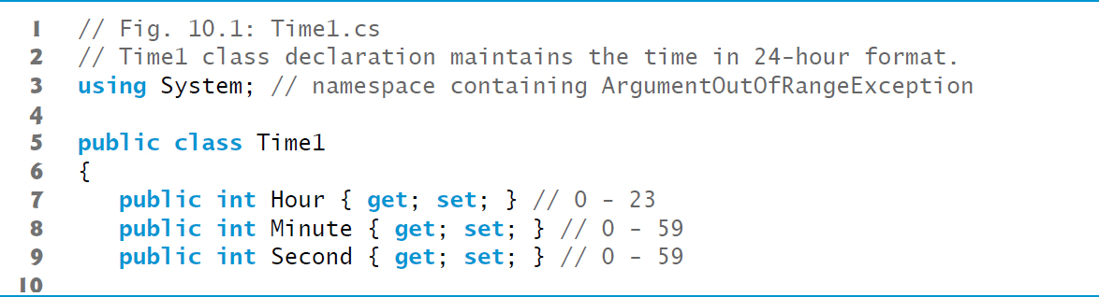
Figure 10.1 Time1 Class Declaration Maintains the Time in 24-Hour Format (1 of 3)

Slide 9
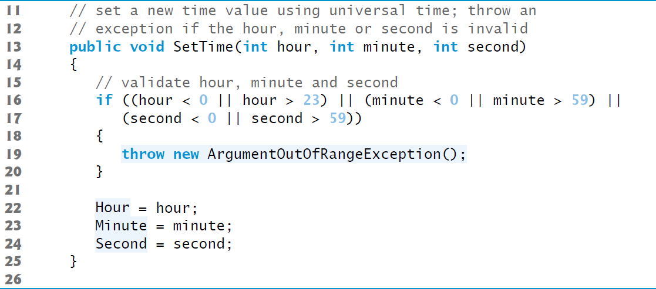
Figure 10.1 Time1 Class Declaration Maintains the Time in 24-Hour Format (2 of 3)

Slide 10
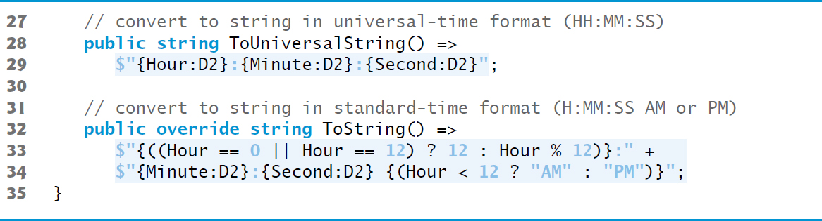
Figure 10.1 Time1 Class Declaration Maintains the Time in 24-Hour Format (3 of 3)

Slide 11
10.2 Time Class Case Study (1 of 8)
public Class
Time1 is a public class—it can potentially can be reused in other projects.
Although we use class Time1 only in this project, from this point forward, we’ll declare as public any class that could potentially be reused in another project.

Slide 12
10.2 Time Class Case Study (2 of 8)
Method SetTime and Throwing Exceptions
Method SetTime is a public method that declares three int parameters and uses them to set the time.
Lines 16–17 test each argument to determine whether the value is out of range. If not, lines 22–24 assign values to the propertoes.
The hour value must be greater than or equal to 0 and less than 24, because universal-time format represents hours as integers from 0 to 23 (e.g., 1 P M is hour 13 and 11 P M is hour 23; midnight is hour 0 and noon is hour 12).

Slide 13
10.2 Time Class Case Study (3 of 8)
Both minute and second values must be greater than or equal to 0 and less than 60.
For values outside these ranges, SetTime throws an ArgumentOutOfRangeException, which notifies the client code that an invalid argument was passed to the method.
The throw statement creates a new object of type ArgumentOutOfRangeException.
The parentheses following the class name indicate a call to the ArgumentOutOfRangeException constructor.

Slide 14
10.2 Time Class Case Study (4 of 8)
After the exception object is created, the throw statement immediately terminates method SetTime and the exception is returned to the code that attempted to set the time.

Slide 15
10.2 Time Class Case Study (5 of 8)
Method ToUniversalString
Method ToUniversalString is an expression-bodied method
The method takes no arguments and returns a string in universal-time format, consisting of six digits—two for the hour, two for the minute and two for the second.
The D2 format specifier formats an integer with two digits and, where needed, a leading 0 if the integer has fewer than two digits.

Slide 16
10.2 Time Class Case Study (6 of 8)
Method ToString
Method ToString (lines 32–34) is an expression-bodied method that takes no arguments and returns a string in which the Hour, Minute and Second values are separated by colons and followed by an A M or P M indicator (e.g., 1:27:06 P M).

Slide 17
10.2 Time Class Case Study (7 of 8)
The Time1Test app class (Figure 10.2) uses class Time1.

Slide 18
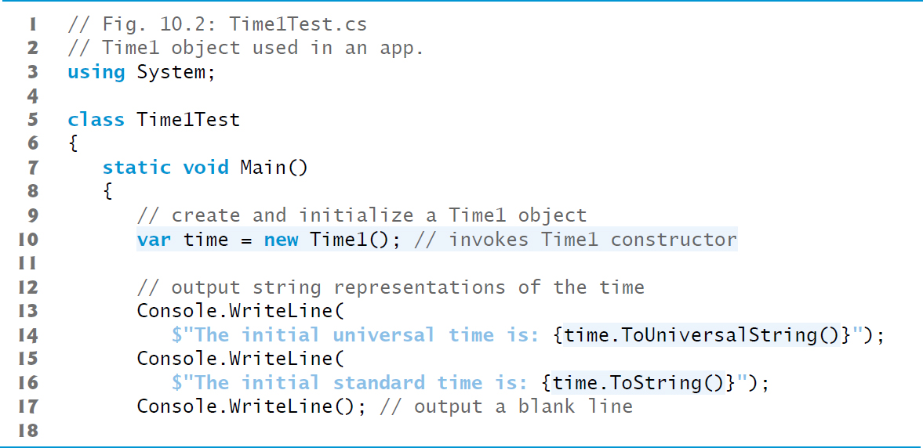
Figure 10.2 Time1 Object Used in an App (1 of 3)

Slide 19
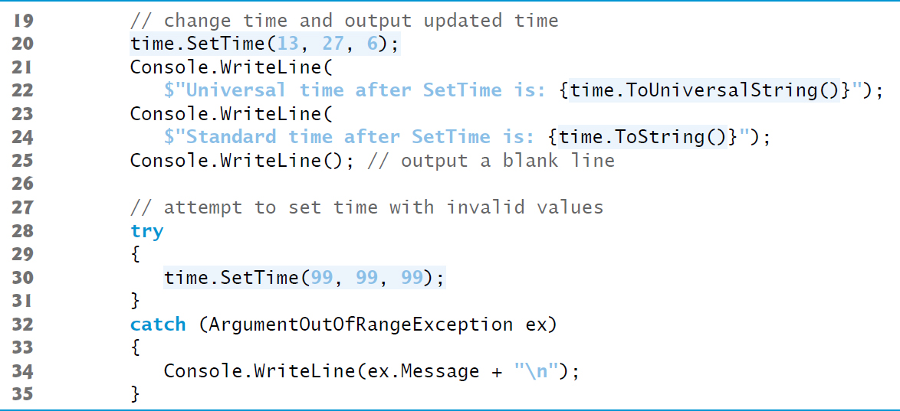
Figure 10.2 Time1 Object Used in an App (2 of 3)

Slide 20
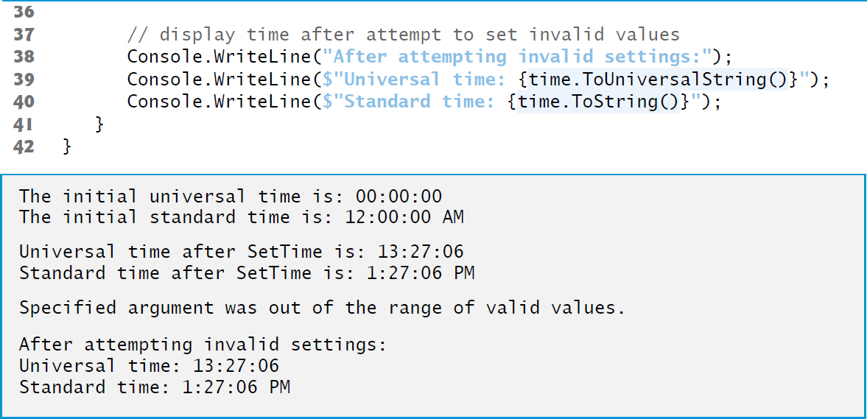
Figure 10.2 Time1 Object Used in an App (3 of 3)

Slide 21
10.2 Time Class Case Study (8 of 8)
Notes on the Time1 Class Declaration
Consider several class-design issues with respect to class Time1.
The time is represented as three integers for the hour, minute and second.
The actual data representation used within the class is of no concern to the class’s clients.
It would be perfectly reasonable for Time1 to represent the time internally as the number of seconds since midnight or the number of minutes and seconds since midnight.
Clients could use the same public methods and properties to get the same results without being aware of this
The Hour, Minute and Second properties would need to be reimplemented to work with the new data representation.

Slide 22
Software Engineering Observation 10.1
Classes simplify programming because the client can use only the public members exposed by the class. Such members are usually client oriented rather than implementation oriented. Clients are neither aware of, nor involved in, a class’s implementation. Clients generally care about what the class does but not how the class does it. Clients do, of course, care that the class operates correctly and efficiently.

Slide 23
Software Engineering Observation 10.2
Interfaces change less frequently than implementations. When an implementation changes, implementation-dependent code must change accordingly. Hiding the implementation reduces the possibility that other parts of the app become dependent on class-implementation details.

Slide 24
Software Engineering Observation 10.3
Date and time manipulations are more complex than the simplified classes we use in this book. For applications that require date and time processing, check out .NET’s DateTimeOffest, DateTime, TimeSpan and TimeZoneInfo value types in namespace System.

Slide 25
10.3 Controlling Access to Members (1 of 2)
The access modifiers public and private control access to a class’s variables, methods and properties.
The primary purpose of public methods/properties is to present to the class’s clients a view of the services the class provides.
Clients of the class need not be concerned with how the class accomplishes its tasks.
A class’s private variables, properties and methods are not directly accessible to the class’s clients.

Slide 26
10.3 Controlling Access to Members (2 of 2)
Figure 10.3 demonstrates that private class members are not directly accessible outside the class.
In this app, we use a modified version of class Time1 that declares private instance variables hour, minute and second, rather than public properties Hour, Minute and Second.
Members of a class—for instance, properties, methods and instance variables—have private access by default.

Slide 27
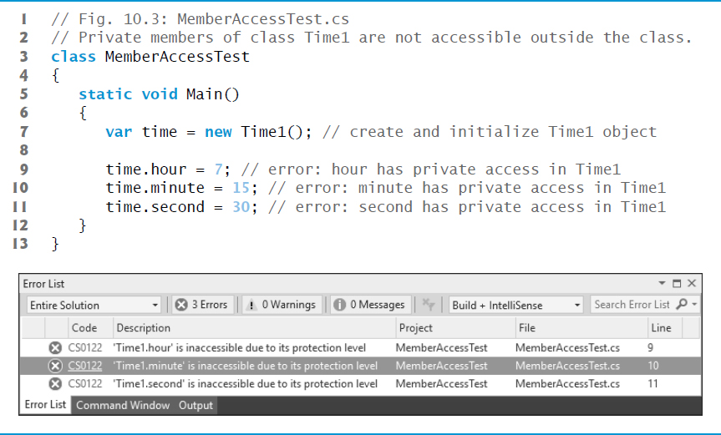
Figure 10.3 Private Members of Class Time1 are Not Accessible Outside the Class

Slide 28
10.4 Referring to the Current Object’s Members with the this Reference (1 of 2)
Every object can access a reference to itself with keyword this.
When a non-static method/property is called, its body implicitly uses keyword this to refer to the object’s instance variables and other non-static class members.
As you’ll see in Figure 10.4, you can also use keyword this explicitly in a non-static method’s body.

Slide 29
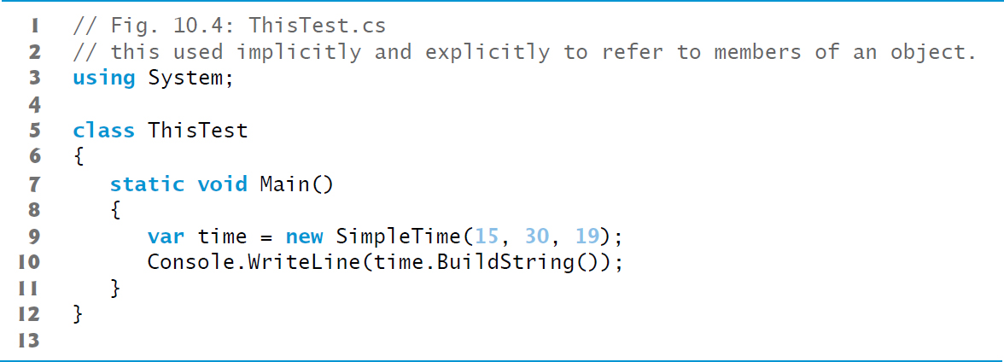
Figure 10.4 This Used Implicitly and Explicitly to Refer to Members of an Object (1 of 3)

Slide 30
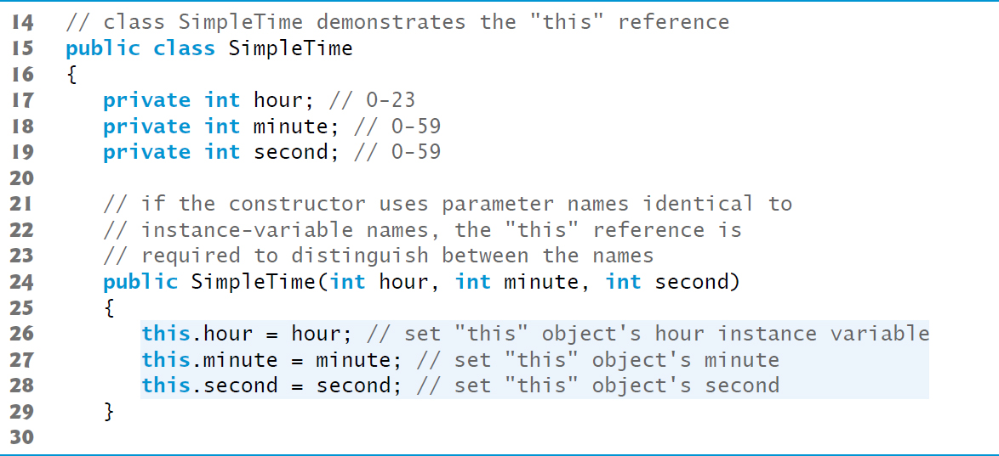
Figure 10.4 This Used Implicitly and Explicitly to Refer to Members of an Object (2 of 3)

Slide 31
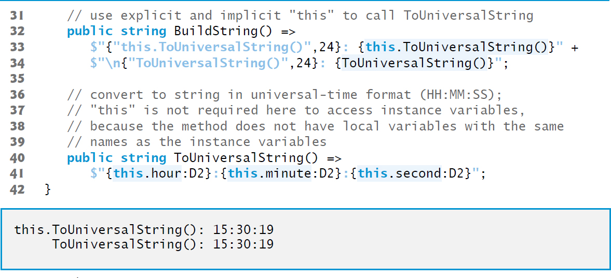
Figure 10.4 This Used Implicitly and Explicitly to Refer to Members of an Object (3 of 3)

Slide 32
10.4 Referring to the Current Object’s Members with the this Reference (2 of 2)
If the constructor’s parameter names are identical to the class’s instance-variable names, so they hide (shadow) the corresponding instance variables.
You can use the this reference to refer to hidden instance variables explicitly.
If a member is not hidden, the this keyword is implied, but can be included explicitly.

Slide 33
Software Engineering Observation 10.4
Using properties throughout a class to access the class’s instance variables normally eliminates shadowing because property names use Pascal Case naming (capital first letter) and parameter names use Camel Case (lowercase first letter).

Slide 34
10.5 Time Class Case Study: Overloaded Constructors (1 of 6)
Overloaded constructors enable objects of a class to be conveniently initialized in different ways.
To overload constructors, simply provide multiple constructor declarations with different signatures.

Slide 35
10.5.1 Class Time2 with Overloaded Constructors
Class Time2 (Figure 10.5) contains overloaded constructors.

Slide 36
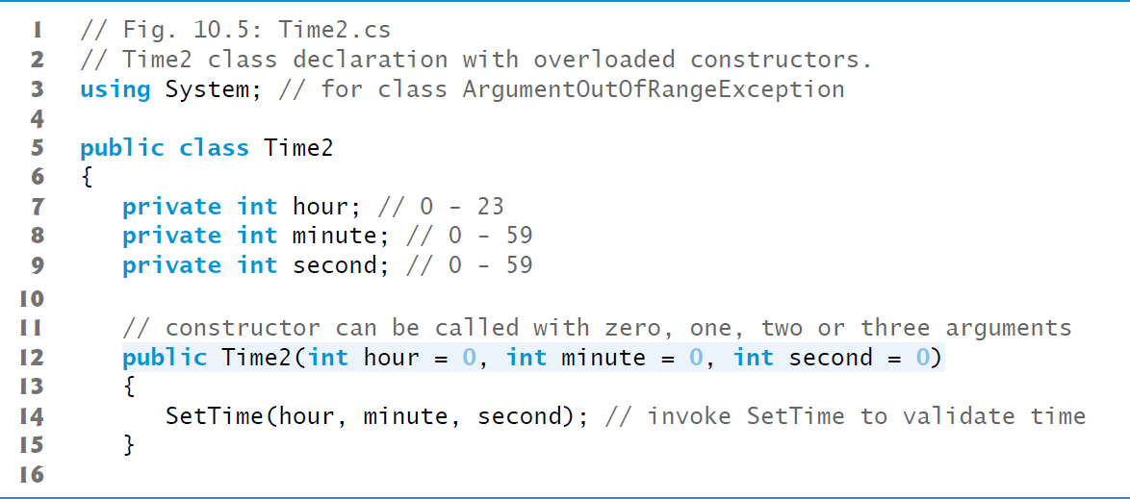
Figure 10.5 Time2 Class Declaration with Overloaded Constructors (1 of 6)

Slide 37
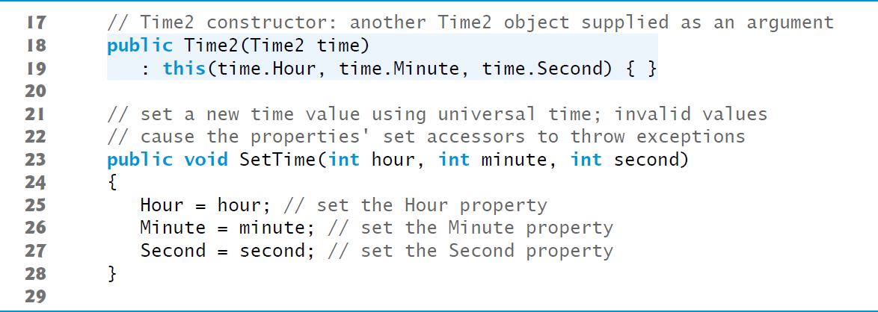
Figure 10.5 Time2 Class Declaration with Overloaded Constructors (2 of 6)

Slide 38
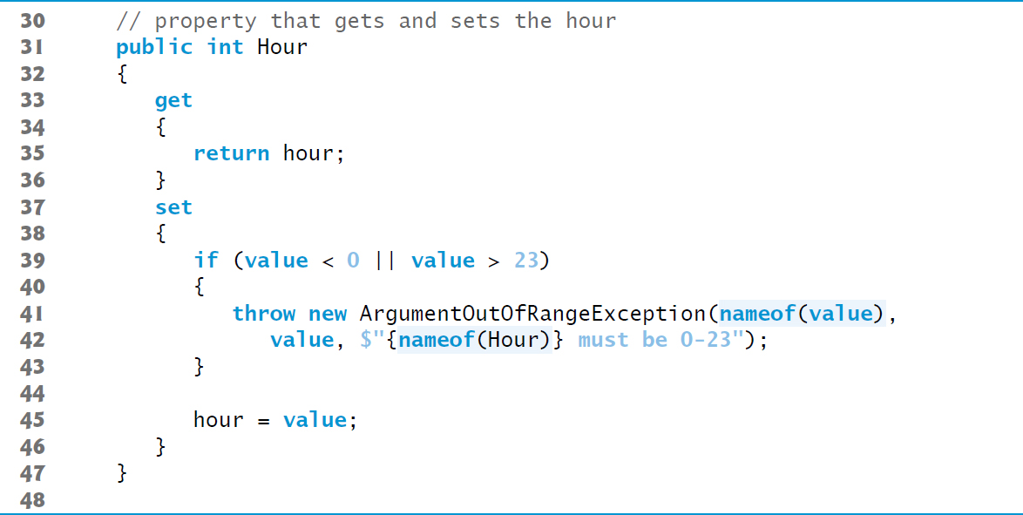
Figure 10.5 Time2 Class Declaration with Overloaded Constructors (3 of 6)

Slide 39
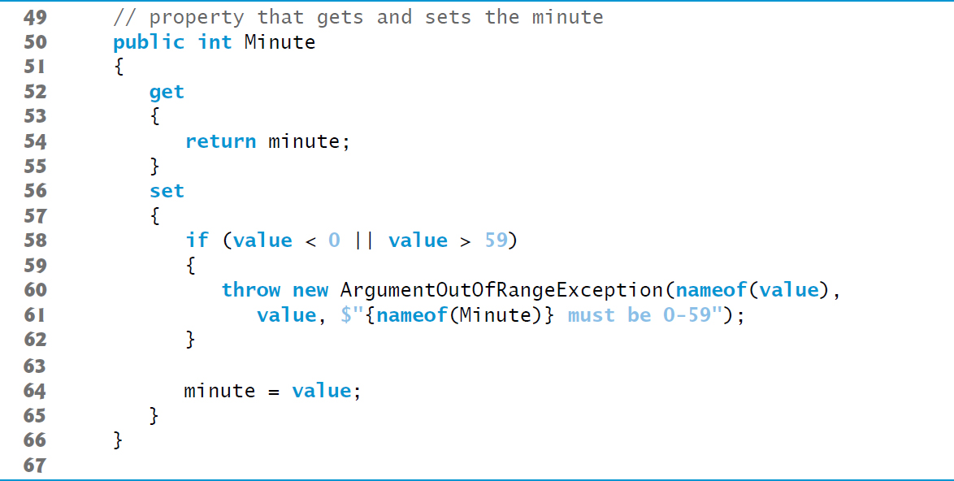
Figure 10.5 Time2 Class Declaration with Overloaded Constructors (4 of 6)

Slide 40
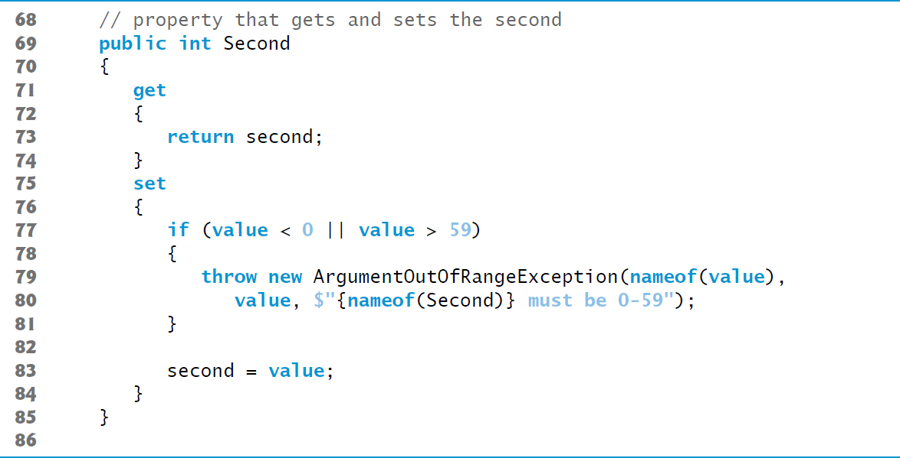
Figure 10.5 Time2 Class Declaration with Overloaded Constructors (5 of 6)

Slide 41
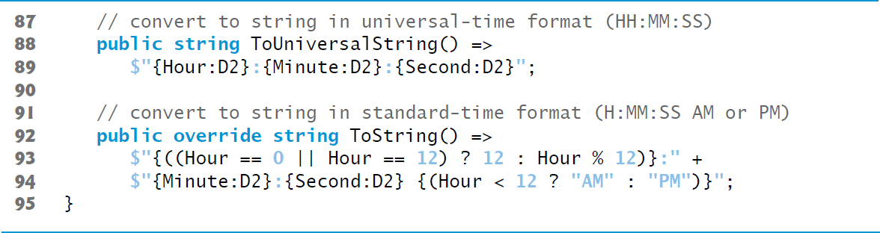
Figure 10.5 Time2 Class Declaration with Overloaded Constructors (6 of 6)

Slide 42
10.5 Time Class Case Study: Overloaded Constructors (2 of 6)
Class Time2’s Three-Argument Constructor
Lines 12–15 declare a constructor with three default parameters.
This is also the class’s parameterless constructor because you can call the constructor without arguments and the compiler will automatically provide the default parameter values.

Slide 43
Common Programming Error 10.1
A constructor can call methods of its class. Be aware that the instance variables might not yet be initialized, because the constructor is in the process of initializing the object. Using instance variables before they have been initialized properly is a logic error.

Slide 44
10.5 Time Class Case Study: Overloaded Constructors (3 of 6)
Using this as in line 19
is called a constructor initializer.
Enables a class to reuse initialization code provided by a constructor, rather than defining similar code in another constructor.

Slide 45
Software Engineering Observation 10.5
Constructor initializers make classes easier to maintain, modify and debug, because the common initialization code can be defined in one constructor and called by others.

Slide 46
10.5 Time Class Case Study: Overloaded Constructors (4 of 6)
Notes Regarding Class Time2’s Methods, Properties and Constructors
Consider changing the representation of the time to a single int value representing the total number of seconds that have elapsed since midnight.
Only the bodies of the methods that access the private data directly would need to change.
There would be no need to modify the bodies of methods SetTime, ToUniversalString or ToString.
When there is no access modifier before a get or set accessor, the accessor inherits the access modifier preceding the property name.

Slide 47
10.5 Time Class Case Study: Overloaded Constructors (5 of 6)
It’s common to include in an exception’s error message a variable’s or property’s identifier.
Can help a client-code programmer understand the context in which the exception occurred.
Prior to
6, you had to hard code these identifiers into your error-messages.
As of
6, you can instead use the nameof operator, which returns a string representation of the identifier enclosed in parentheses.

Slide 48
Software Engineering Observation 10.6
When executing a method of a class, if that method has a reference to another object of the same class (typically received via a parameter), the method can access all of that other object’s data and methods (including those that are private).

Slide 49
Good Programming Practice 10.1
When you need to include an identifier in a string literal, use the nameof operator rather than hard coding the identifier’s name in the string. If you right click an identifier in Visual Studio then use the Rename… option to change the identifier’s name throughout your code, the string that nameof returns will be updated automatically with the identifier’s new name.

Slide 50
Software Engineering Observation 10.7
When implementing a method of a class, using the class’s properties to access the class’s private data simplifies code maintenance and reduces the likelihood of errors.

Slide 51
10.5 Time Class Case Study: Overloaded Constructors (6 of 6)
Class Time2Test (Figure 10.6) creates six Time2 objects to invoke the overloaded Time2 constructors.

Slide 52
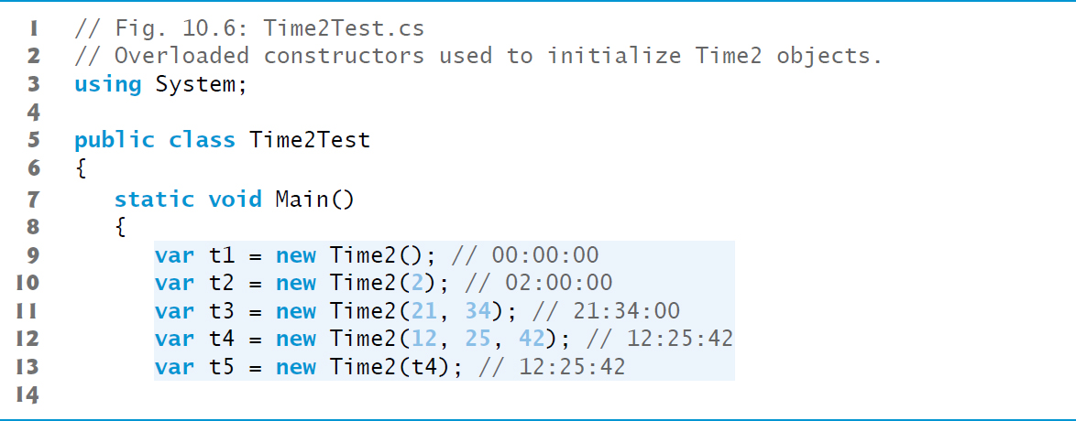
Figure 10.6 Overloaded Constructors Used to Initialize Time2 Objects (1 of 4)

Slide 53
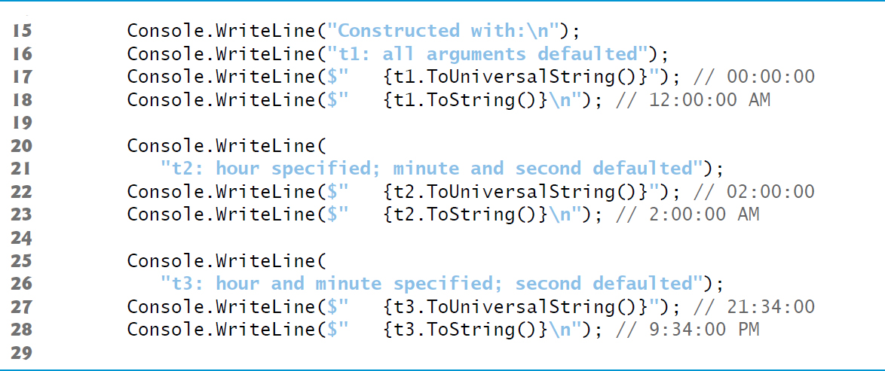
Figure 10.6 Overloaded Constructors Used to Initialize Time2 Objects (2 of 4)

Slide 54
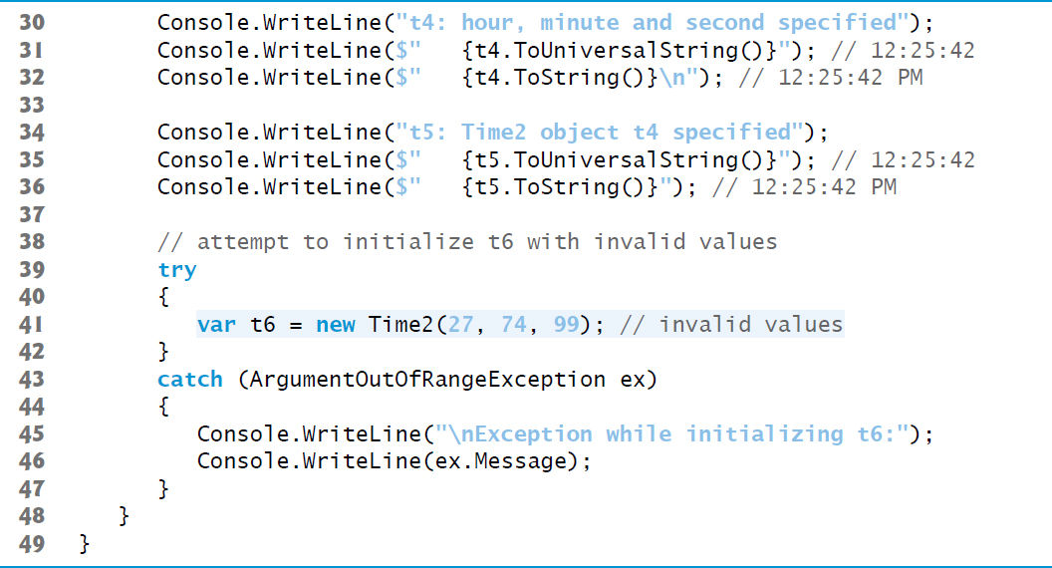
Figure 10.6 Overloaded Constructors Used to Initialize Time2 Objects (3 of 4)

Slide 55
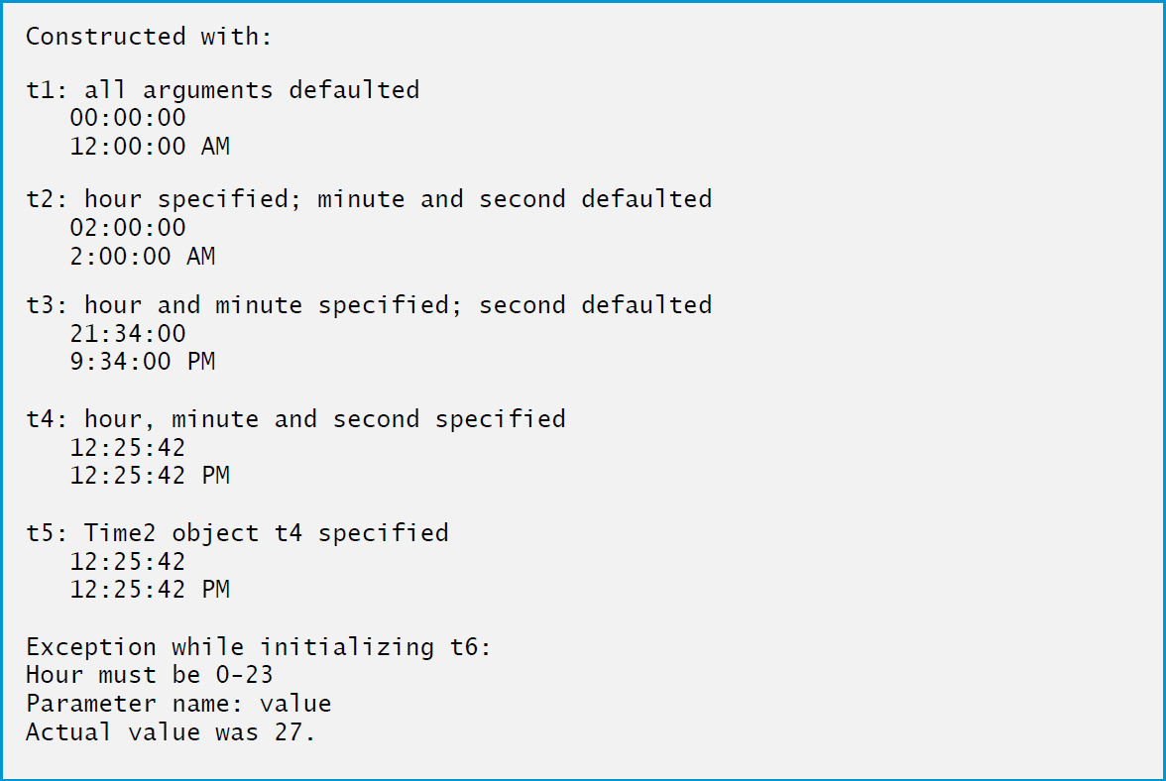
Figure 10.6 Overloaded Constructors Used to Initialize Time2 Objects (4 of 4)

Slide 56
10.6 Default and Parameterless Constructors
Every class must have at least one constructor.
If you do not provide any constructors in a class’s declaration, the compiler creates a default constructor that takes no arguments when it is invoked.
The compiler will not create a default constructor for a class that explicitly declares at least one constructor.
If you have declared a constructor, but want to be able to invoke the constructor with no arguments, you must declare a parameterless constructor.

Slide 57
10.7 Composition
A class can have objects of values types or references to objects of other classes as members.
This is called composition and is sometimes referred to as a has-a relationship.

Slide 58
Software Engineering Observation 10.8
One form of software reuse is composition, in which a class contains references to other objects. Recall that classes are reference types. A class can have a property of its own type—for example, a Person class could have Mother and Father properties of type Person that reference other Person objects.

Slide 59
10.7.1 Class Date
Class Date (Figure 10.7) declares instance variables month and day, and auto-implemented property Year (line 9) to represent a date.

Slide 60
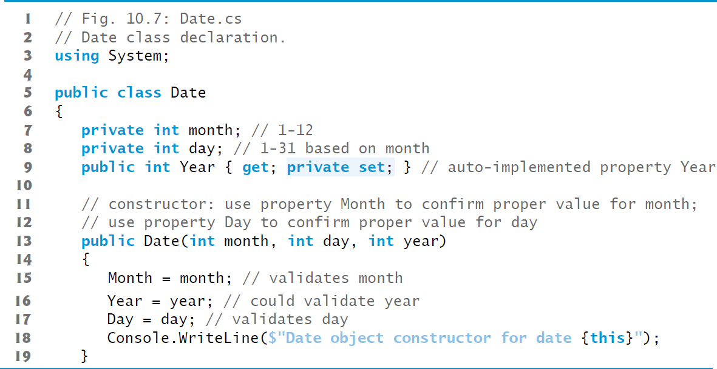
Figure 10.7 Date Class Declaration (1 of 4)

Slide 61
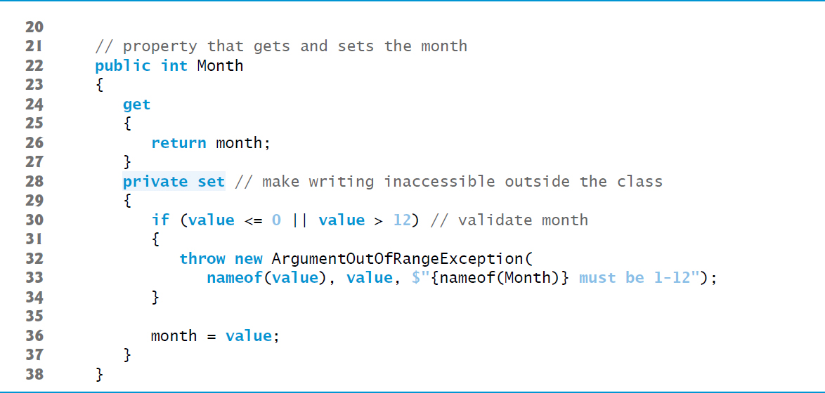
Figure 10.7 Date Class Declaration (2 of 4)

Slide 62
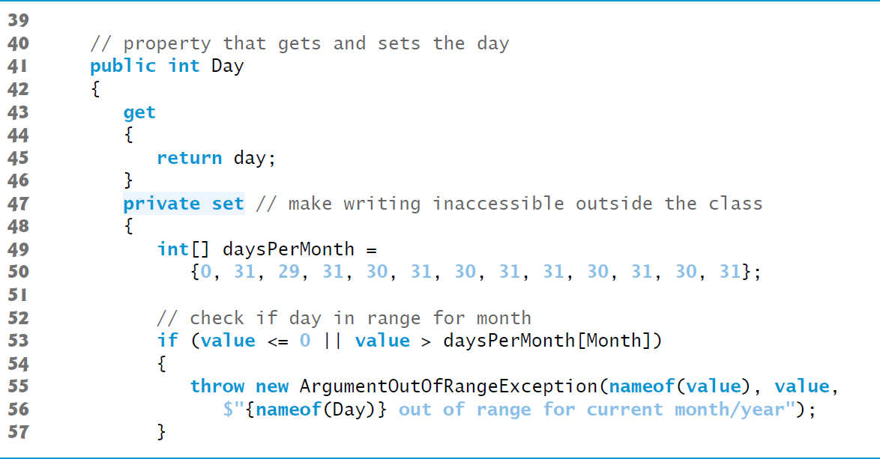
Figure 10.7 Date Class Declaration (3 of 4)

Slide 63
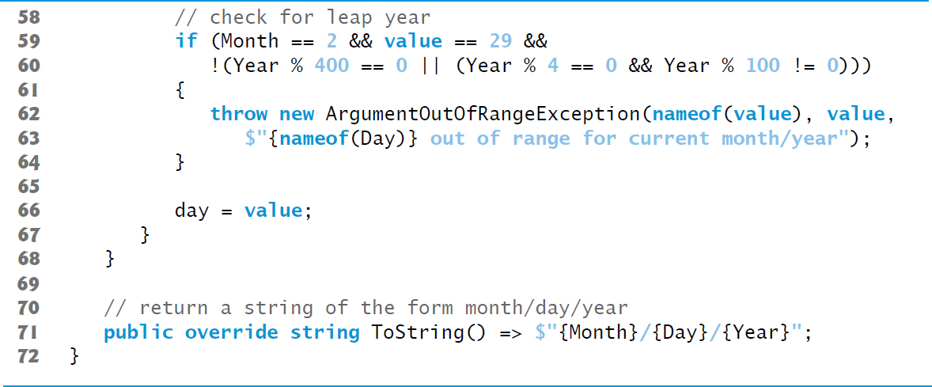
Figure 10.7 Date Class Declaration (4 of 4)

Slide 64
10.7.2 Class Employee
Class Employee (Figure 10.8) has public auto-implemented, getter-only properties FirstName, LastName, BirthDate and HireDate
Demonstrates that a class can have references to objects of other classes as members

Slide 65
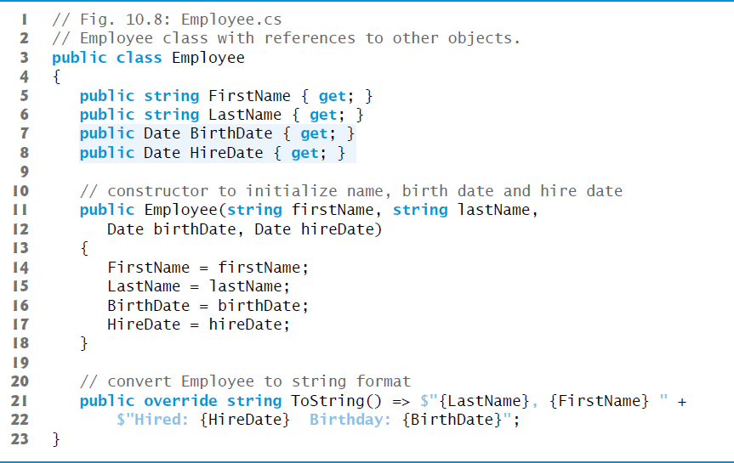
Figure 10.8 Employee Class with References to Other Objects

Slide 66
10.7.3 Class EmployeeTest
Class Employee­Test (Figure 10.9) creates two Date objects to represent an Employee’s birthday and hire date, respectively.

Slide 67
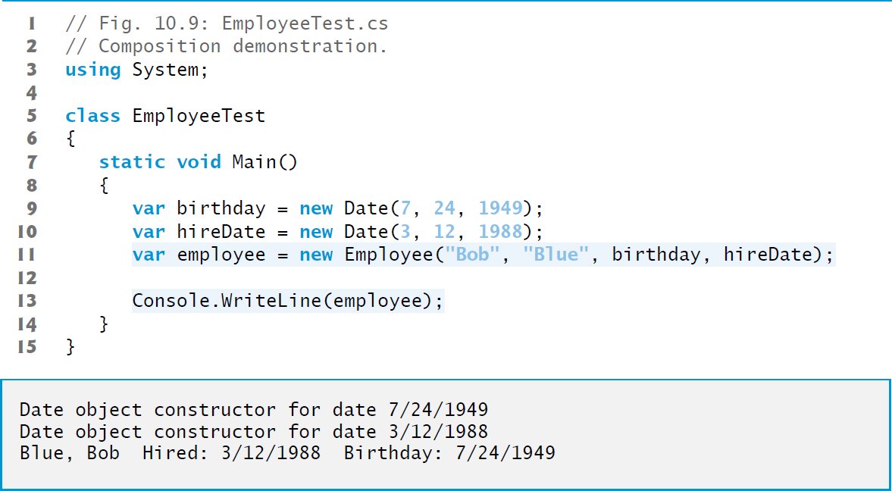
Figure 10.9 Composition Demonstration

Slide 68
10.8 Garbage Collection and Destructors (1 of 4)
Every object you create uses various system resources, such as memory.
In many programming languages, these system resources are reserved for the object’s use until they’re explicitly released by the programmer.
If all the references to the object that manages the resource are lost before the resource is explicitly released, it can no longer be released. This is known as a resource leak.

Slide 69
10.8 Garbage Collection and Destructors (2 of 4)
The Common Language Runtime (C L R) uses a garbage collector to reclaim the memory occupied by objects that are no longer in use.
When there are no more references to an object, the object becomes eligible for destruction.
Every object has a destructor that’s invoked by the garbage collector to perform termination housekeeping before its memory is reclaimed.

Slide 70
10.8 Garbage Collection and Destructors (3 of 4)
A destructor’s name is the class name, preceded by a tilde, and it has no access modifier in its header.
After an object’s destructor is called, the object becomes eligible for garbage collection—the memory for the object can be reclaimed by the garbage collector.
Memory leaks are less likely in
than languages like C and C++ (but some can still happen in subtle ways).

Slide 71
10.8 Garbage Collection and Destructors (4 of 4)
Other types of resource leaks can occur, for example if an app fails to close a file that it has opened.
A problem with the garbage collector is that it is not guaranteed to perform its tasks at a specified time. For this reason, destructors are rarely used.

Slide 72
Software Engineering Observation 10.9
A class that uses resources, such as files on disk, should provide a method to eventually release the resources. Many Framework Class Library classes provide Close or Dispose methods for this purpose. Section 13.6 introduces the Dispose method, which is then used in many later examples. Close methods are typically used with objects that are associated with files (Chapter 17) and other types of so-called streams of data.

Slide 73
10.9 Static Class Members (1 of 4)
A static variable or property is used when only one copy of a particular variable should be shared by all objects of a class.
A static variable or property represents classwide information—all objects of the class share the same piece of data.
The declaration of a static variable or property begins with the keyword static.

Slide 74
Software Engineering Observation 10.10
Use a static variable when all objects of a class must share the same copy of the variable.

Slide 75
10.9 Static Class Members (2 of 4)
The scope of a static variable is the body of its class.
A class’s public static members can be accessed by qualifying the member name with the class name and the member access (·) operator, as in Math.P I.
A class’s private static class members can be accessed only through the class’s methods and properties.
To access a private static member from outside its class, a public static method or property can be provided.

Slide 76
Common Programming Error 10.2
It’s a compilation error to access or invoke a static member by referencing it through an instance of the class, like a non-static member.

Slide 77
Software Engineering Observation 10.11
static variables, methods and properties exist, and can be used, even if no objects of that class have been instantiated. static members are available as soon as the class is loaded into memory at execution time.

Slide 78
10.9 Static Class Members (3 of 4)
A static method (or property) cannot access non-static class members directly, because a static method (or property) can be called even when no objects of the class exist.
For the same reason, this cannot be used in a static method—the this reference always refers to a specific object of the class.
When a static method is called, it does not know which object to manipulate and there might not be any objects of its class in memory.

Slide 79
10.9 Static Class Members (4 of 4)
Class Employee declares private static auto-implemented property Count to maintain a count of the number of Employee objects that have been created.
Count’s set accessor is private, because only class Employee should be able to modify Count’s value.
Count is a static auto-implemented property, so the compiler creates a corresponding private static variable that Count manages.
When you declare a static variable and do not initialize it, the compiler initializes it to the type’s default value (in this case, 0).

Slide 80
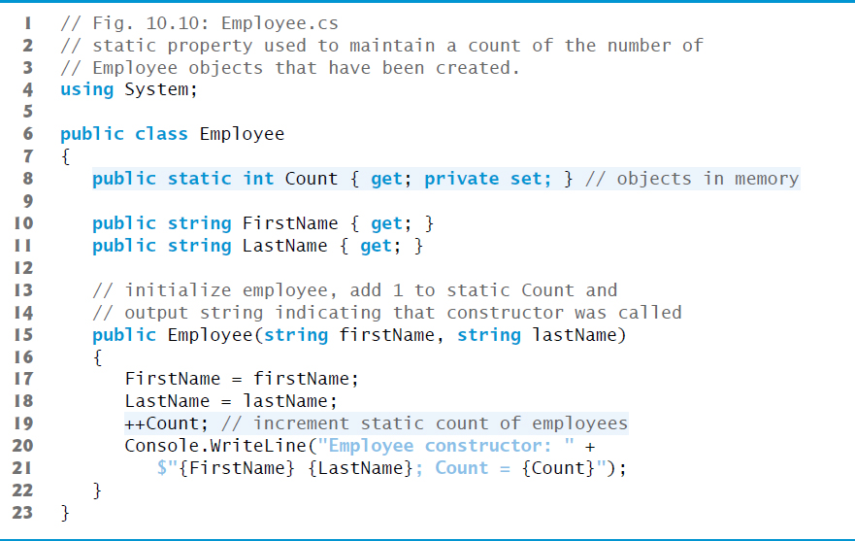
Figure 10.10 Static Property Used to Maintain a Count of the Number of Employee Objects That Have Been Created

Slide 81

Software Engineering Observation 10.12
are immutable—they cannot be modified after they’re created. Therefore, it’s safe to have many references to one string. This is not normally the case for objects of most other classes. If string objects are immutable, you might wonder why we’re able to use operators
Actually, string objects in
to concatenate strings. String-concatenation operations actually result in a new string object containing the concatenated values. The original string objects are not modified.

Slide 82
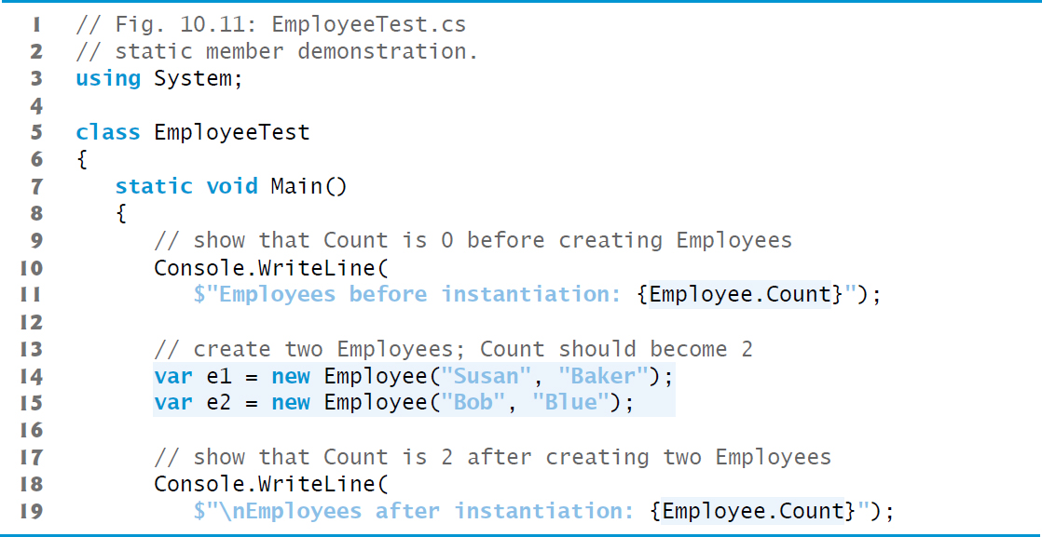
Figure 10.11 Static Member Demonstration (1 of 2)

Slide 83
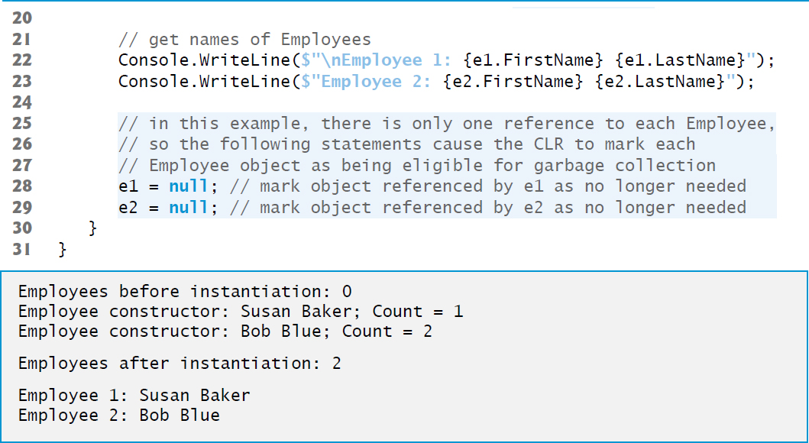
Figure 10.11 Static Member Demonstration (2 of 2)

Slide 84
10.10 Readonly Instance Variables (1 of 4)
The principle of least privilege states that code should be granted the amount of privilege and access needed to accomplish its designated task, but no more.
Constants declared with const must be initialized to a constant value when they’re declared.
provides keyword readonly to specify that an instance variable of an object is not modifiable and that any attempt to mod­ify it after the object is constructed is an error.
A readonly variable’s identifier uses Pascal Case by convention.

Slide 85
10.10 Readonly Instance Variables (2 of 4)
Although readonly instance variables can be initialized when they’re declared, this isn’t required.
A readonly variable should be initialized by each of the class’s constructors or in the variable’s declaration.
Each constructor can assign values to a readonly instance variable multiple times—the variable doesn’t become unmodifiable until after the constructor completes execution.
If a constructor does not initialize the readonly variable, the variable uses the same default value as any other instance variable.

Slide 86
Software Engineering Observation 10.13
Declaring an instance variable as readonly helps enforce the principle of least privilege. If an instance variable should not be modified after the object is constructed, declare it to be readonly to prevent modification.

Slide 87
10.10 Readonly Instance Variables (3 of 4)
const members must be assigned values at compile time.
const members can be initialized only with other constant values, such as integers, string literals, characters and other const members.
Constant members with values that cannot be determined at compile time—such as constants that are initialized with the result of a method call—must be declared with keyword readonly, so they can be initialized at execution time.
Variables that are readonly can be initialized with more complex expressions, such as an array initializer or a method call that returns a value or a reference to an object.

Slide 88
Common Programming Error 10.3
Attempting to modify a readonly instance variable anywhere but in its declaration or the object’s constructors is a compilation error.

Slide 89
Error-Prevention Tip 10.1
Attempts to modify a readonly instance variable are caught at compilation time rather than causing execution-time errors. It’s always preferable to get bugs out at compile time, if possible, rather than allowing them to slip through to execution time (where studies have found that repairing bugs is often much more costly).

Slide 90
Software Engineering Observation 10.14
If a readonly instance variable is initialized to a constant only in its declaration, it’s not necessary to have a separate copy of the instance variable for every object of the class. The variable should be declared const instead. Constants declared with const are implicitly static, so there will only be one copy for the entire class.

Slide 91
10.10 Readonly Instance Variables (4 of 4)
6 Getter-Only Auto-Implemented Properties and readonly
When an auto-implemented property has only a get accessor, the property can be used only to read the value, so the compiler implicitly declares the corresponding private instance variable as readonly.
Getter-only auto-implemented properties can be initialized in their declarations or in constructors.

Slide 92
10.11.1 Using the Class View Window (1 of 2)
The Class View displays the fields, methods and properties for all classes in a project.
Select View > Class View to display the Class View as a tab in the same position within the I D E
Figure 10.12 shows the Class View for the Time1 project of Figure 10.1 (class Time1) and Figure 10.2 (class TimeTest1).

Slide 93
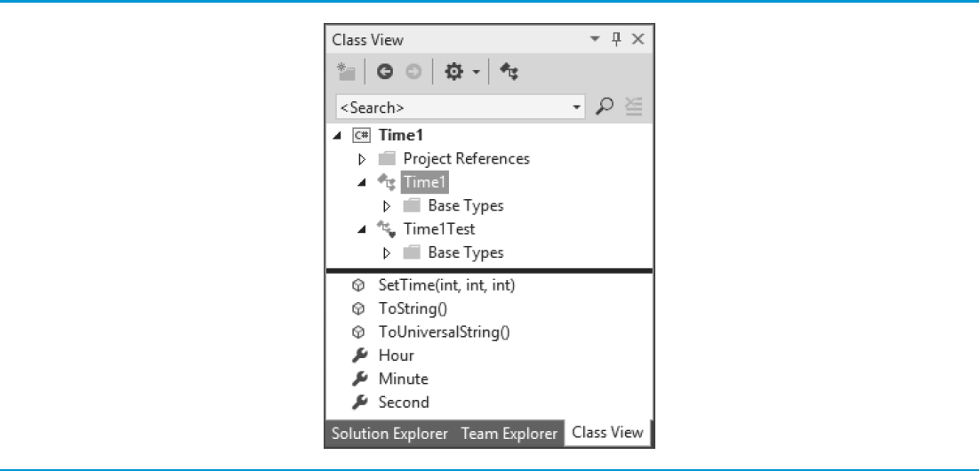
Figure 10.12 Class View of Class Time1 (Figure 10.1) and Class Time1Test (Figure 10.2)

Slide 94
10.11.1 Using the Class View Window (2 of 2)
The view follows a hierarchical structure, with the project name as the root.
When a class is selected, its members appear in the lower half of the window.
public methods are indicated by purple boxes
public properties are indicated by wrench icons
If a class has any private members, those members’ icons contain small padlocks.

Slide 95
10.11.2 Using the Object Browser (1 of 2)
You can use the Object Browser to learn about the functionality provided by a specific class.
To open the Object Browser, select View → Object Browser.
Figure 10.13 depicts the Object Browser when the user navigates to the Math class in namespace System in the assembly mscorlib.dll (Microsoft Core Library).

Slide 96
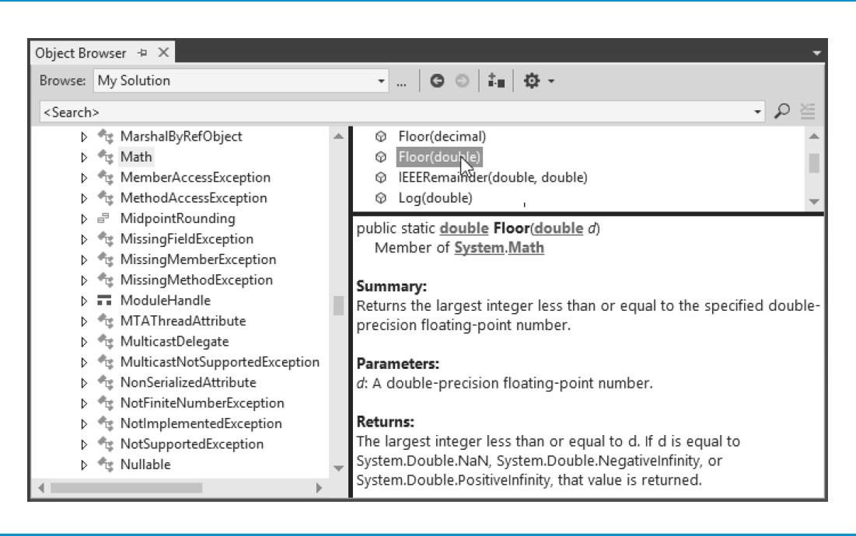
Figure 10.13 Object Browser for Class Math

Slide 97
10.11.2 Using the Object Browser (2 of 2)
The Object Browser lists all methods provided by class Math in the upper-right frame.
If you click the name of a member in the upper-right frame, a description of that member appears in the lower-right frame.
The Object Browser can be a quick mechanism to learn about a class or one of its methods.

Slide 98
10.12 Object Initializers (1 of 2)
Object initializers allow you to create an object and initialize its public properties (and public instance variables, if any) in the same statement.
This can be useful when a class does not provide an appropriate constructor to meet your needs, but does provide a constructor that can be called with no arguments and properties that you can use to set the class’s data
new Time2 is immediately followed by an object-initializer list—a comma-separated list in curly braces ({ }) of properties and their values.

Slide 99
10.12 Object Initializers (2 of 2)
Each property name can appear only once in the object-initializer list.
The object initializer executes the property initializers in the order in which they appear.

Slide 100
10.13 Operator Overloading; Introducing Struct
You can create operators that work with objects of your own types—via a process called operator overloading.
You can overload most operators.

Slide 101
10.13.1 Creating Value Types with Struct (1 of 2)
simple numeric types are value types.
simple types like int and double are actually aliases for struct types—an int is defined by the struct System.Int32, a long by System.Int64, a double by System.Double and so on.
Operator overloading also can be applied to classes

Slide 102
10.13.1 Creating Value Types with Struct (2 of 2)
When to Declare a struct Type
Microsoft recommends using classes for most new types, but recommends a struct if:
the type represents a single value
the size of an object is 16 bytes or smaller
For the complete list of struct recommendations, see
https://msdn.microsoft.com/library/ms229017

Slide 103
10.13.2 Creating Value Types with Struct
Value type ComplexNumber (Figure 10.14) overloads the plus (+), minus (-) and multiplication (*) operators to enable programs to add, subtract and multiply instances of class ComplexNumber using common mathematical notation.

Slide 104
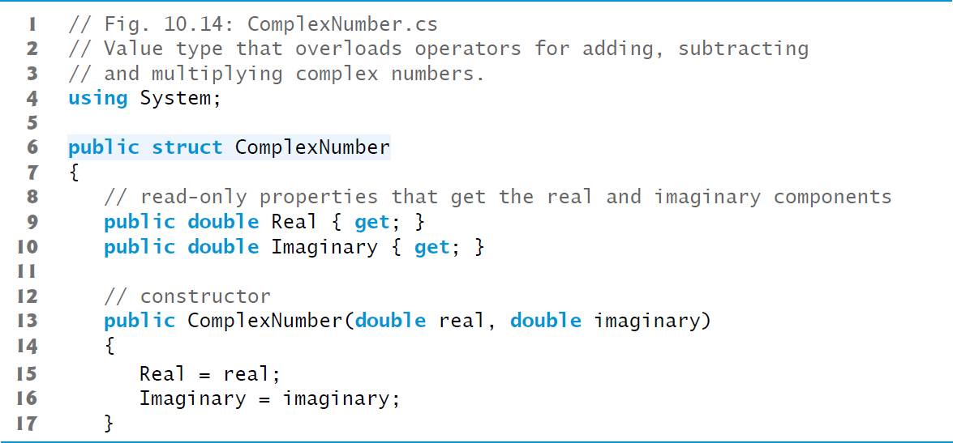
Figure 10.14 Value Type That Overloads Operators for Adding, Subtracting and Multiplying Complex Numbers (1 of 3)

Slide 105
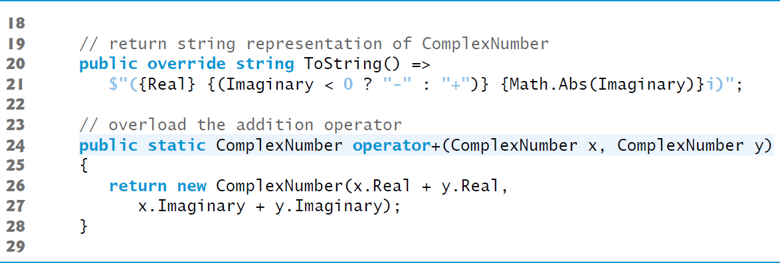
Figure 10.14 Value Type That Overloads Operators for Adding, Subtracting and Multiplying Complex Numbers (2 of 3)

Slide 106
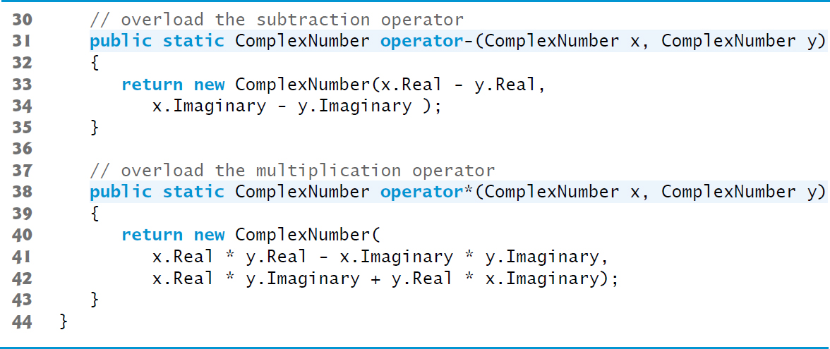
Figure 10.14 Value Type That Overloads Operators for Adding, Subtracting and Multiplying Complex Numbers (3 of 3)

Slide 107
10.13.2 Creating Value Types with Struct (1 of 2)
Unlike a class, you cannot define a parameterless constructor for a struct.
The compiler always provides a default constructor that initializes the struct’s instance variables to their default values.
structs cannot specify initial values in instance variable or property declarations.

Slide 108
10.13.2 Creating Value Types with Struct (2 of 2)
Keyword operator, followed by an operator symbol (such as +), indicates that a method overloads the specified operator.
Overloaded operator methods are required to be public and static.
Methods that overload binary operators must take two arguments—the first is the left operand and the second is the right operand.

Slide 109
Software Engineering Observation 10.15
Overload operators to perform the same function or similar functions on objects as the operators perform on objects of simple types. Avoid nonintuitive use of operators.

Slide 110
Software Engineering Observation 10.16
At least one parameter of an overloaded operator method must be of the type in which the operator is overloaded. This prevents you from changing how operators work on simple types.

Slide 111
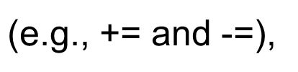

Software Engineering Observation 10.17
Though you cannot overload the arithmetic assignment operators
allows you to use them with any type that declares the corresponding arithmetic operator

Slide 112
10.13.3 Class ComplexTest
Class ComplexTest (Figure 10/15) demonstrates the overloaded operators for adding, subtracting and multiplying ComplexNumbers.

Slide 113
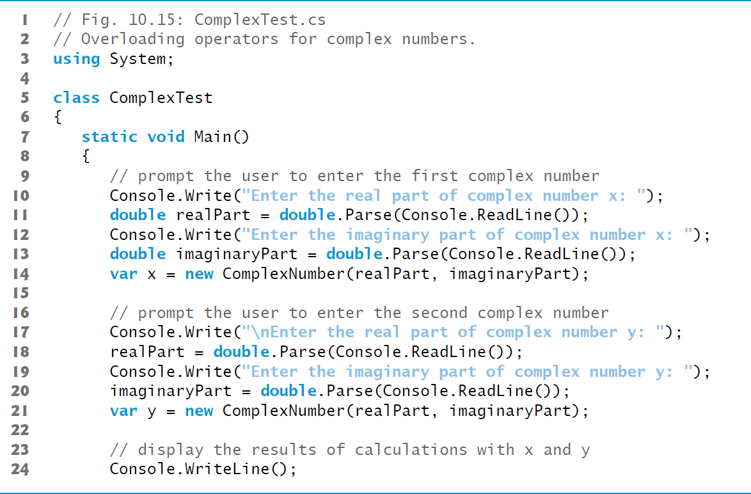
Figure 10.15 Overloading Operators for Complex Numbers (1 of 2)

Slide 114
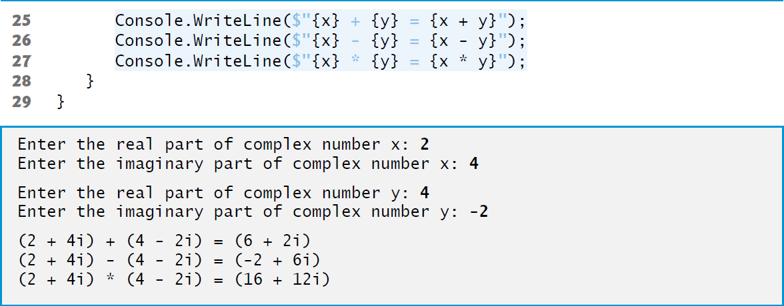
Figure 10.15 Overloading Operators for Complex Numbers (2 of 2)

Slide 115
10.14 Time Class Case Study: Extension Methods (1 of 6)
You can use extension methods to add functionality to an existing type without modifying the type’s source code.
L I N Q’s capabilities are implemented as extension methods.
Figure 10.16 uses extension methods to add two new methods to class Time2 (Section 10.5)—DisplayTime and AddHours.

Slide 116
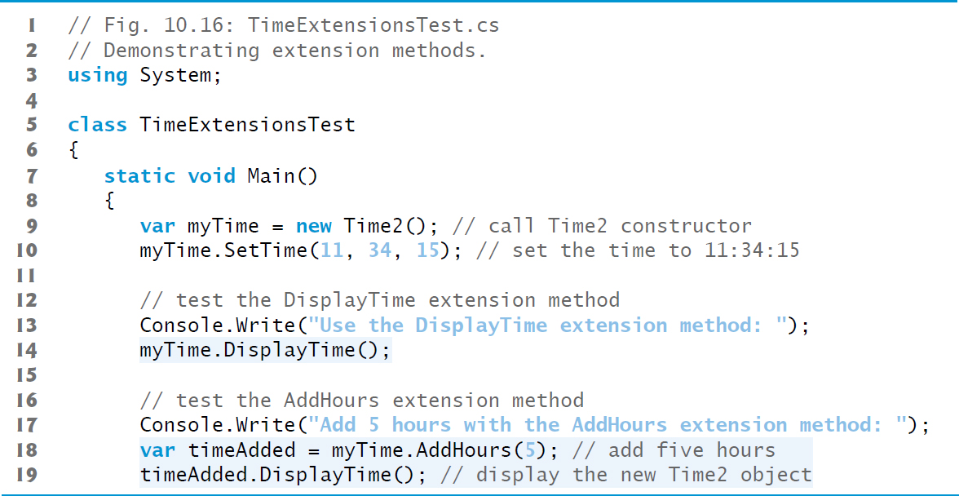
Figure 10.16 Demonstrating Extension Methods (1 of 4)

Slide 117
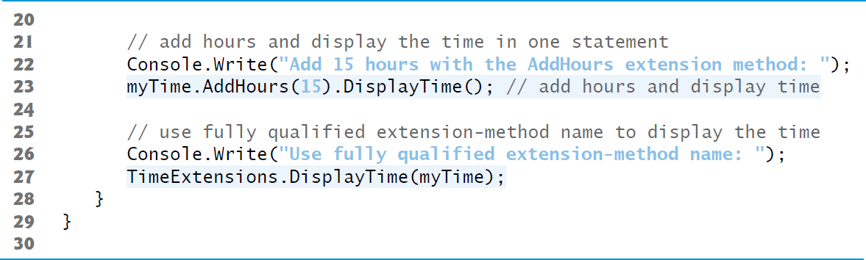
Figure 10.16 Demonstrating Extension Methods (2 of 4)

Slide 118
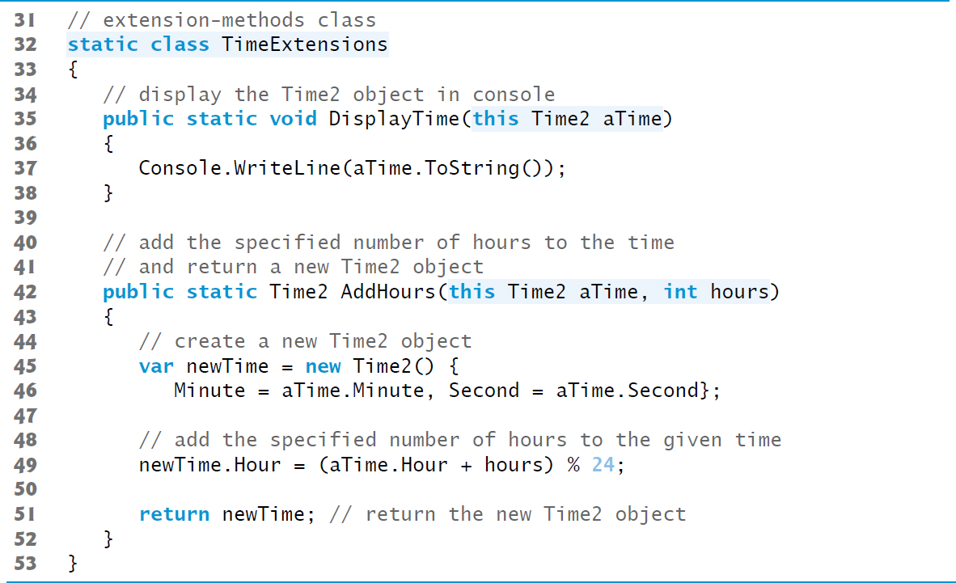
Figure 10.16 Demonstrating Extension Methods (3 of 4)

Slide 119

Figure 10.16 Demonstrating Extension Methods (4 of 4)

Slide 120
10.14 Time Class Case Study: Extension Methods (2 of 6)
The this keyword before a method’s first parameter notifies the compiler that the method extends an existing class.
The type of the first parameter specifies the type of object on which you can call the extension method.
Extension methods must be defined as static methods in a static class.
A static class can contain only static members and cannot be instantiated.

Slide 121
10.14 Time Class Case Study: Extension Methods (3 of 6)
When you call an extension method, you do not provide an argument for the first parameter.
The compiler implicitly passes the object that calls the method as the extension method’s first argument.
This allows you to call the extension method as if it were an instance method.
IntelliSense displays extension methods with the class’s instance methods and identifies them with a similar icon that also has a down arrow.

Slide 122
10.14 Time Class Case Study: Extension Methods (4 of 6)
Line 23 uses both extension methods (DisplayTime and AddHours) in a single statement to add 15 hours to the original myTime and display the result in the console.
Multiple method calls in the same statement are known as cascaded method calls.
When a method returns an object, you can follow the method call with a member access operator (·) then call a method on the object that was returned.
The methods are called from left to right.

Slide 123
10.14 Time Class Case Study: Extension Methods (5 of 6)
You can call an extension method via its fully qualified name by using the name of the class in which the extension method is defined (TimeExtensions), followed by the member access operator (·), the method name (DisplayTime) and its argument list.
When using the fully qualified method name, you must specify an argument for extension method’s first parameter.

Slide 124
10.14 Time Class Case Study: Extension Methods (6 of 6)
If a type for which you declare an extension method already defines an instance method with the same name and a compatible signature, the instance method will shadow (i.e., hide) the extension method.
If a predefined type is later updated to include an instance method that shadows an extension method, the compiler does not report any errors and the extension method does not appear in IntelliSense.

Slide 125

Copyright

